Slide 1
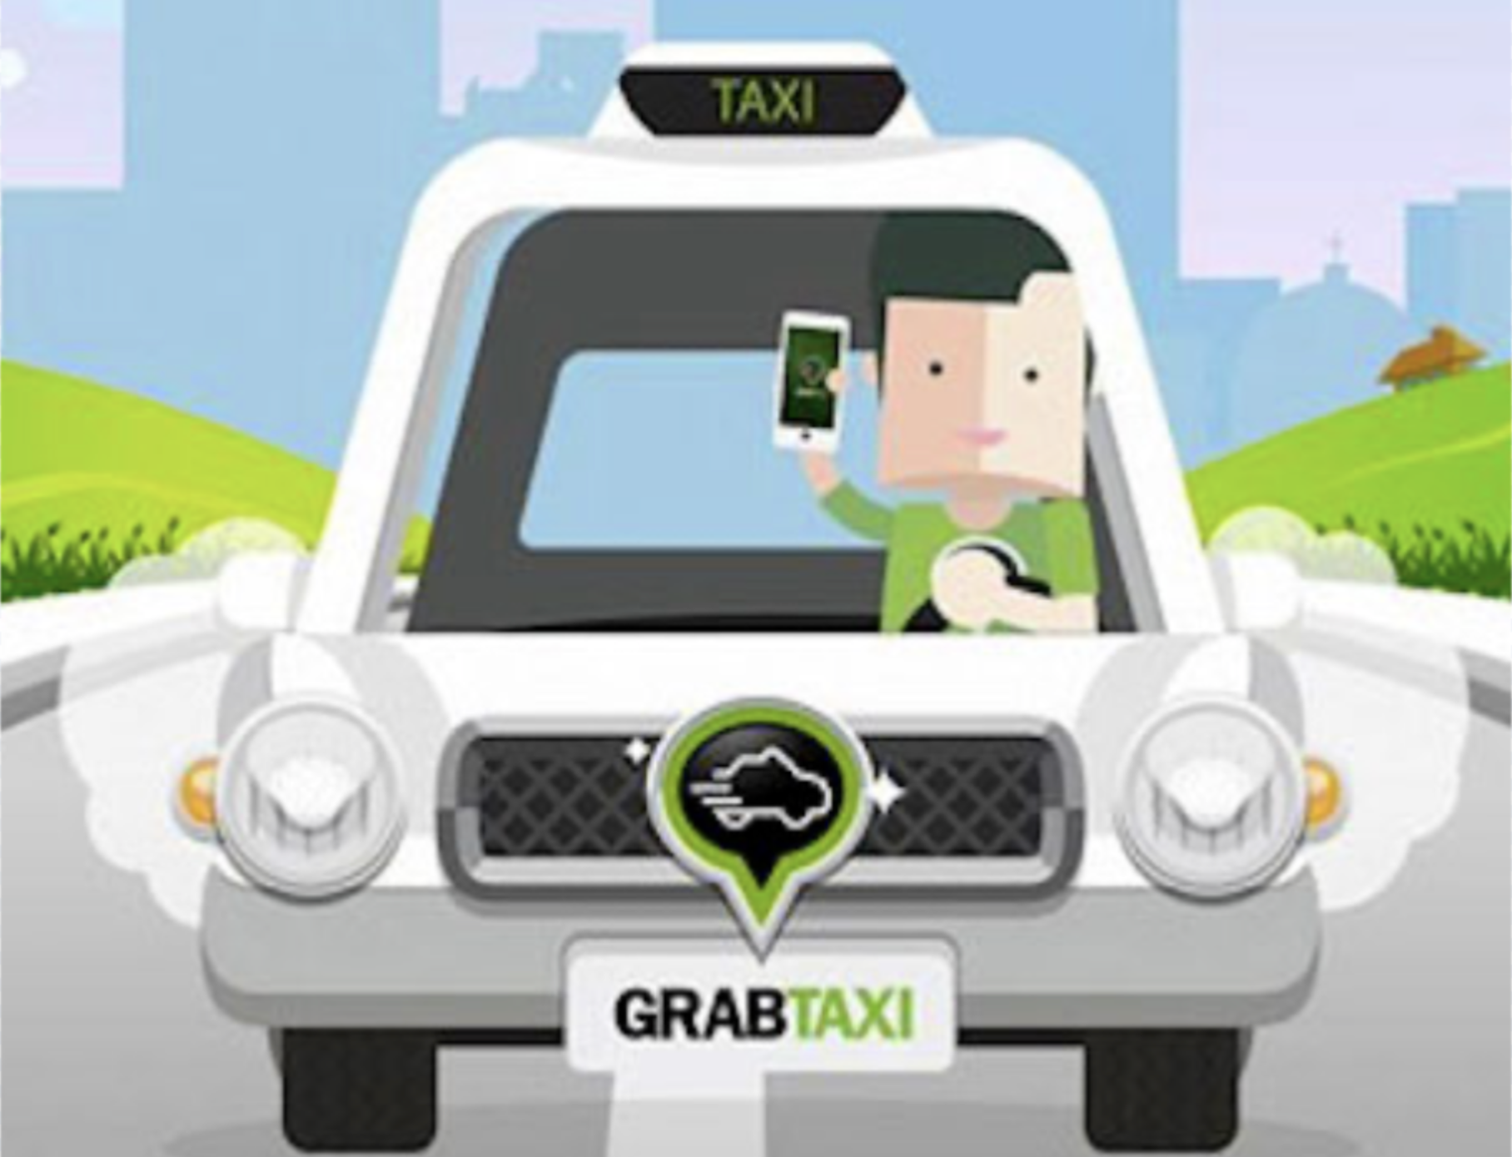
SOFTWARE DEVELOPMENT WITH GRAB
Group Members: Alyssa Woon 221143R
Amanda Tan 220970G
Jovan Lim 220913R
Terrence Cheong 221127M

Slide 2
Table of contents
01
02
BACKGROUND OF GRAB
PROJECT OBJECTIVE
03
04
05
METHOD CHOSEN
GAME INTRODUCTION
SHOWCASE OF GAME
INTRODUCTION TO GRAB
PURPOSE OF OUR SOFTWARE DEVELOPMENT
WHAT APPLICATION DID WE USE FOR OUR GAME
WHAT OUR GAME IS ABOUT
HOW THE GAME WORKS

Slide 3
01
BACKGROUND OF GRAB

Slide 4
BACKGROUND INFORMATION ON GRAB
The platform was founded by Anthony Tan and Tan Hooi Ling in 2012, under MyTeksi
In 2013, the platform expanded to GrabTaxi
In 2014, it was then moved into its headquarters, which is based in Singapore and rebranded as Grab
Grab is a Singaporean Multinational Technology company that provides users with different services that can be done via a mobile app
Grab currently operates in many countries, and is now Southeast Asia’s first decacorn
In 2016, Grab added a new in-app function which is known as GrabChat

Slide 5
02
PROJECT OBJECTIVE

Slide 6
PROJECT OBJECTIVE
Our aim in this project would be to create a game system, where users are allowed to play it at any time of the day
From the game played, they would be a point system where the points accumulated by users can be exchanged for vouchers
Through this game implemented, it would allow Grab to drive more business profits for the company
With the attractiveness of the game, it would be able to build trust and brand loyalty between the business and the users

Slide 7
PROJECT OBJECTIVE
One way in which the game would allow Grab to gain a competitive edge would be that through the attractiveness of the game, it increases its users rate
One example would be that other applications such as Gojek only give vouchers to users during milestones periods
With the implementation of the game, it would allow users to receive vouchers much more regularly as the game can be played throughout the day
A special function would be that upon successfully completing the game, they would be able to get the chance in spinning the wheel, which provides them with a small extra gift voucher

Slide 8
03
METHOD CHOSEN

Slide 9

METHOD CHOSEN
For our software development, we have decided to use Scratch in completing the project

Slide 10
04
GAME INTRODUCTION

Slide 11
HOW DOES THE GAME WORKS?
In this game, users will be given one chance per day, in which they will be able to play four different levels
Users are required to avoid hitting any obstacles, and each obstacle that they pass would allow them to gain one point to their score
At each stage, there is a different score target that they have to hit, before being able to spin the wheel and move on to the next level
At each level, the score target would increase, making it harder for the user to hit the final level

Slide 12
HOW DOES THE GAME WORKS?
At each level, the speed of the character would also increase, which increases the challenge for the user
Upon hitting the score target of each level, users would then be prompted to spin the wheel, which then contains different prizes at different levels
Once they have spun the wheel, they would then be able to proceed on to the next level

Slide 13
05
GAME SHOWCASE

